Slide 1

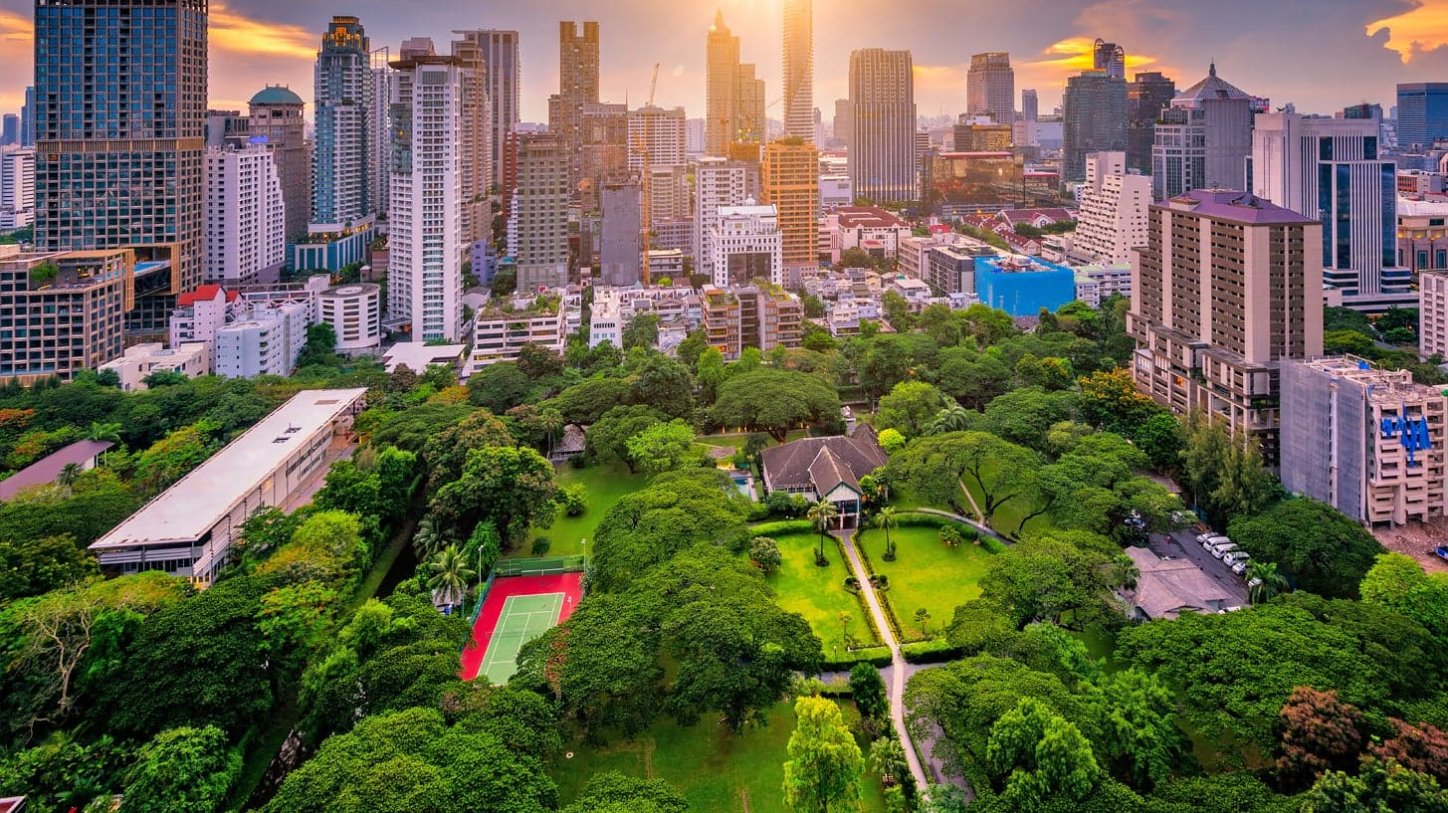
Bangkok Property Investment Analysis
Author : Chittawat Pourpongpan

Slide 2
Content
Fact about Bangkok
Problem Analysis & Aim
Data Description
Methodology
Result
Evaluation
Conclusion
Future Work

Slide 3
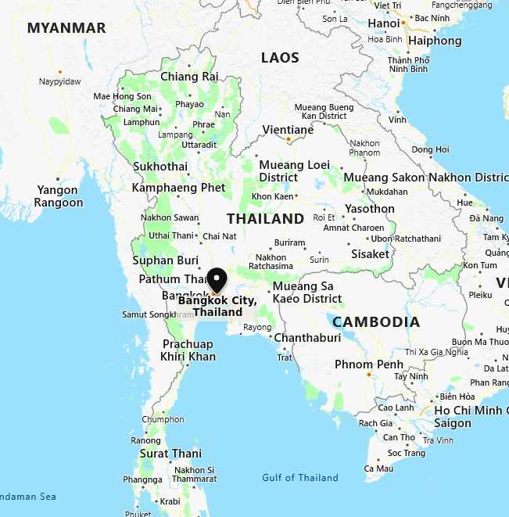
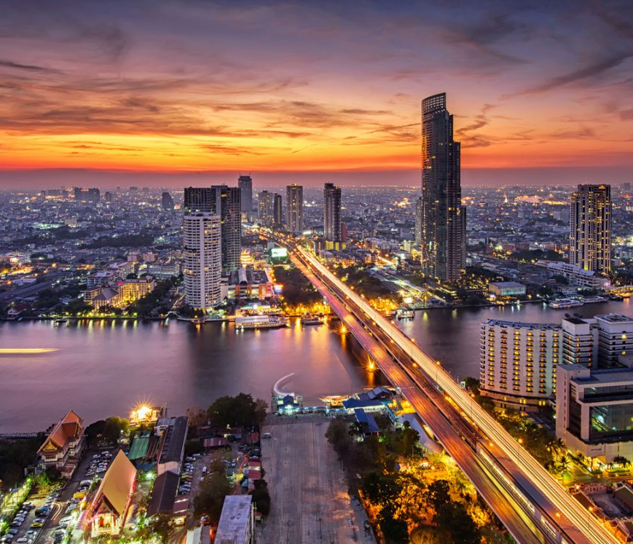
Fact About Bangkok
Capital City of Thailand
Consist of 50 Districts
Population : 8.281 Million
#1 Global Destination City in 2018 by Forbes

Slide 4
Problems Analysis and Goal
Problem
- With the size of the metropolis, it is important to analyse the suitable district for property investment
Goal
- Analyse the suitable area to invest in property
- The analysis will be based on districts
Target Audience
- Investor who interested to invest Bangkok’s property

Slide 5
Data Description
District Information Data
District Name
Latitude & Longitude
Foursquare API Data
Number of schools in each district
Number of Supermarkets
Public Transport Availability
Number of Medical Centre
Available Green Area

Slide 6
Methodology
Bangkok’s districts data collection
Districts Venue data collection
Districts Venue data filtering
Data Preprocessing
Data Modelling
Result Analysis

Slide 7
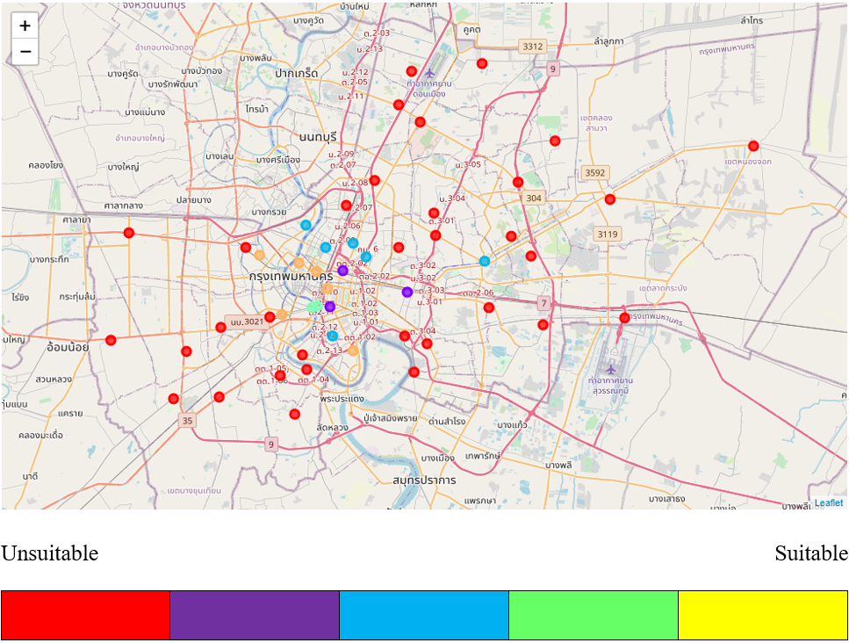
Result
Most of the districts in the outer zone of Bangkok is in the unsuitable cluster
The districts in the inner zone is in the variety of clusters.

Slide 8
Evaluation (Result)
The cluster was developed based on available facility
District with yellow label have high and balanced number of facility
The district in the outer zone of Bangkok have the number for each facility less than 10 venues

Slide 9
Evaluation (Analysis Problem)
Current API limit 100 venues per API call
Radius of venue search not cover all area of districts
Other factor need to be considered to increased the accuracy e.g. population density, property value

Slide 10
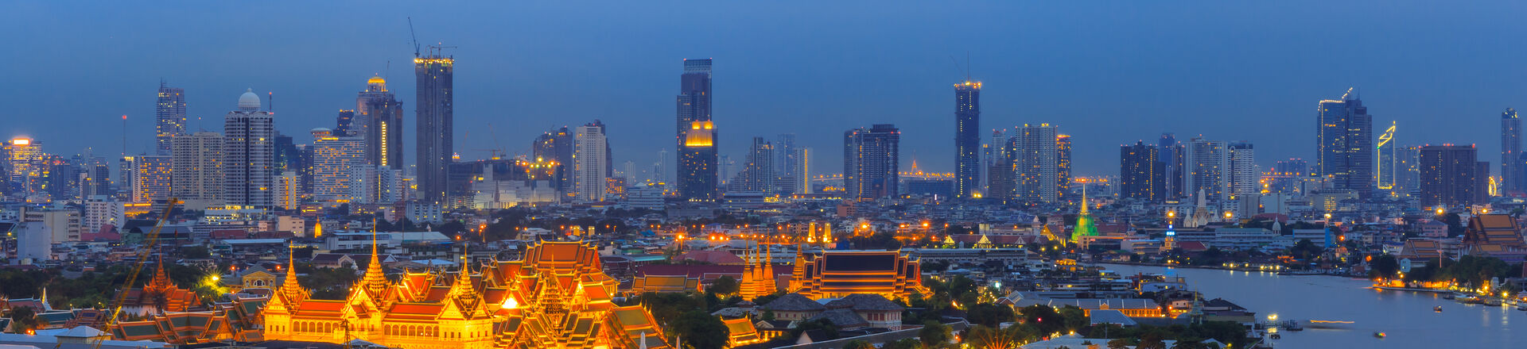
Conclusion
The district listed are most suitable for property investment
Bangkok Noi
Pathum Wan
Phranakorn
Pom Prap Sattru Pai
Thonburi
Yannawa

Slide 11
Future Work
Take Population density into account
Take property price into account
Use different API e.g. Google Place API
Expand the search to cover all area in district

Slide 12
Reference
https://www.forbes.com/sites/ericrosen/2019/09/04/the-worlds-most-visited-city-is-bangkok/#25cdc2edcd26
https://en.wikipedia.org/wiki/List_of_districts_of_Bangkok
https://developer.foursquare.com/

